Slide 1



Agentic DevOps
AI-powered agents operating as a member of your dev team, automating, optimizing, and accelerating every stage of the software lifecycle.
GitHub Models
GitHub Copilot
SRE Agent
Every developer can be an AI developer with full model accessibility and fine-tuning in GitHub to speed up app development.
Agent Mode
Coding Agent
App Modernization
AI-powered operator, continuously monitoring and optimizing apps in production.
AI-powered pair programmer, performing multi-step tasks at the developer’s command
AI-powered peer programmer, automating routine tasks and jobs to be done across the software lifecycle.
GitHub Copilot extends AI-assisted capabilities to accelerate modernization and upgrades for .NET and Java apps
//Build - Public Preview
//Build - Public Preview
//Build - Public Preview
Notes:
Indeed, GitHub Copilot serves as the foundation supporting our vision for agentic DevOps, and together with tools like GitHub Models and the Site Reliability Engineering Agent in Azure, we are well on the way to empowering developer teams to adopt agentic DevOps.
During early stages, GitHub Models integrates with GitHub to provide developers with an easy to navigate environment for testing, evaluating, and fine-tuning AI apps and their underlying models, while GitHub Spark provides an AI-native, natural language experience that helps devs prototype by rapidly transforming ideas into deployed apps.
Throughout development, new tools in GitHub Copilot like Agent Mode, Software Engineering Agent, and App modernization agent expand the capabilities available to devs to support multi-step processes throughout development—empowering them to hand off routine tasks around everything from coding, reviewing, and testing, to writing documentation and modernizing their apps—and focus on more high-value, creative work.
And at the far end of the software lifecycle, the Site Reliability Engineering agent in Azure supports engineers deploying, operating, and maintaining applications in production.

Slide 2
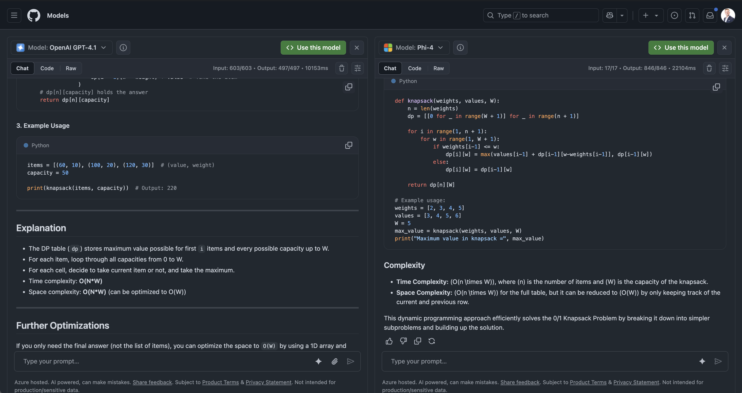
GitHub Models
AI development natively embedded in the GitHub experience
Side-by-side evaluation of a curated list Azure AI foundry models native in the GitHub experience
Prompt engineering at scale to store, version, and manage prompts as code
Streamlined, one-click deployments through Azure integrations
Notes:
GitHub Models extends leading AI models from Azure AI Foundry directly to developers using GitHub, now with native integration into the GitHub experience and workflow.
This models-as-a-service solution streamlines AI development by embedding models directly into the GitHub user experience, alongside repositories, enabling familiar workflows such as pull requests, commits, code reviews, and CI/CD.
This AI-native experience supports a prompts-as-code approach that enables prompt versioning for collaboration and automation of model evaluations through GitHub Actions.
Developers can instantly experiment with leading models from OpenAI, Meta, Cohere, Microsoft, and Mistral, evaluate the best model based on cost and performance, rapidly prototype AI apps and agents, and deploy them to production.

Slide 3
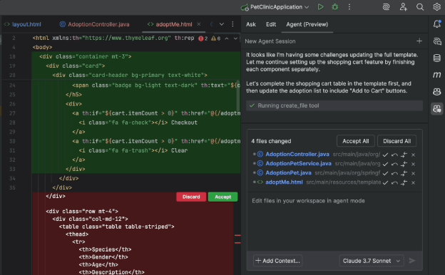
Agent Mode
GitHub Copilot
Supercharge the AI-assisted coding experience directly in your IDE
Expand your AI capabilities beyond autocomplete by assigning multi-step coding tasks directly from your IDE
Leverage an AI-powered peer programmer that can build new features, refactor legacy code, and heal itself when things break
Analyze a codebase, edit files, run tests, fix errors, and suggest terminal commands—all from a single prompt
Use agent mode in the IDE of your choice with support for Visual Studio and Visual Studio Code, and public preview support for Xcode, Eclipse, and JetBrains
Notes:
GitHub Copilot agent mode supercharges the AI-assisted coding experience to become a true peer programmer.
Acting alongside developers in their IDE, agent mode can build features, refactor legacy code, and even heal itself when things break.
It goes far beyond autocomplete to help developers analyze a codebase, edit across multiple files, run tests, fix errors, and suggest terminal commands, all from a single prompt.
Available in VS Code and Visual Studio today, agent mode is expanding to new IDEs, including JetBrains, Eclipse, and Xcode with public preview support being announced at Build 2025.

Slide 4
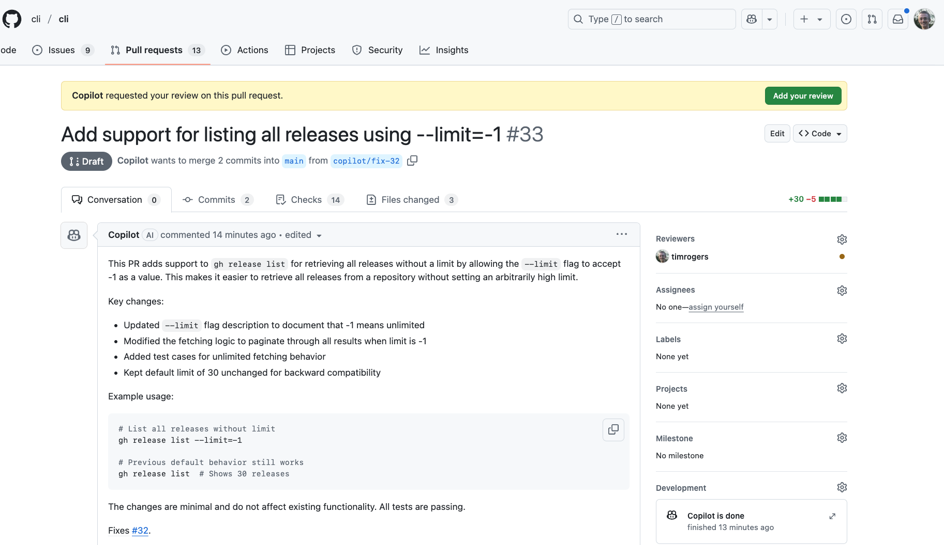
Coding Agent
GitHub Copilot
Agentic capability in GitHub to enhance team productivity like an AI teammate
Assign issues to GitHub Copilot and get back pull requests, automatically validated with tests and linters
Stay in control by working with Copilot just like any other developer and iterating through pull request reviews
Tailor Copilot to your needs by customizing its dev environment, adding custom instructions, and providing external context through MCP servers
Notes:
Developers can now assign GitHub Copilot a range of development tasks from autonomously refactoring code, improving test coverage, and upgrading dependency to fixing defects and implementing new features.
For complex tasks, GitHub Copilot can even collaborate with other agents across all stages of the software lifecycle. Operating as a member of the development team, GitHub Copilot relieves developers of routine tasks to focus developers on more impactful tasks.

Slide 5
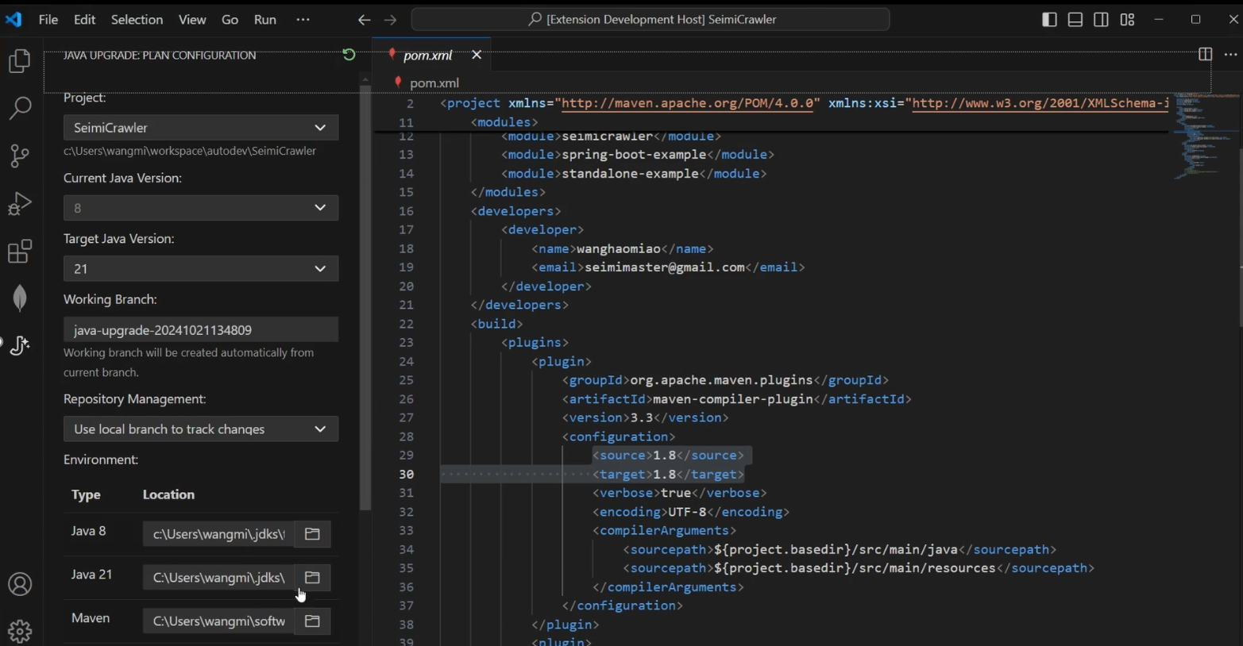
App Modernization
GitHub Copilot
Modernize Java and .NET apps faster than ever with AI agents
Quickly upgrade Java or .NET versions and associated frameworks with AI agents to increase app performance
Perform end-to-end code assessment and remediation for apps to migrate to Azure
Use AI agents to auto remediate code change and bug fixes for moving to Azure app platform services
Stay in control with developer guidance, leverage organizational knowledge/best practices, and validate
Notes:
Developers can now offload complex and time-consuming tasks to rapidly update, upgrade and modernize Java and .NET applications in GitHub Copilot.
App modernization agents intelligently analyze applications, dependencies and issues, understanding legacy applications, programming languages, frameworks and the unique characteristics of your infrastructure to update, transform and modernize applications at scale.
GitHub Copilot now automates code analysis to understand key dependencies and issues, remediating issues to keep existing applications up to date, improving performance and security while reducing license costs.

Slide 6
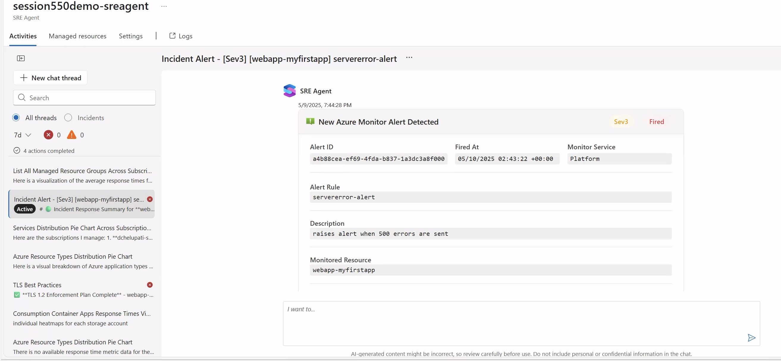
SRE Agent
AI-powered incident management and resource optimization in production
Automatic incident management reduces the number of pager alerts for human SREs
Proactive diagnosis and mitigation to improve application uptime, protecting revenue and reputation
Automated deployments and autonomous rollbacks across large-scale environments help scale your ops without scaling the costs
Continuous monitoring of health and performance of Azure resources, so talent can focus on high-value projects
Notes:
The SRE agent helps cloud developers reduce the cost of operations while improving uptime.
Today, SREs face several challenges, such as, alert fatigue, analyzing root cause quickly, manual workflows, and delivering to the SLA. SRE Agent can offload these tasks and reduce the toil for SREs.
It can automatically respond to production alerts, autonomously mitigate issues, and determine root cause analysis (RCA) bringing resolution time down from hours to minutes. SRE Agent continuously monitors application health and performance for production applications on Azure, including Kubernetes, PaaS, Serverless, and Database services, to build context and provide insights for faster troubleshooting.
Also, by working with SWE agent capabilities in GitHub Copilot, the SRE agent can proactively identify application issues and rapidly drive to resolution with development teams and agent services.
This new service proactively addresses application issues to reduce system downtime, significantly accelerate recovery and autonomously drive resolutions with minimal developer and operator resources.

